Slide 1
How To Create A Page...
Anchor

Slide 2
In Wordpress...
When editing a page, go to the “Text” version of the webpage (the tab located on the right side of the “Visual” tab).
Find the text, within which you would like to place the link to be clicked on.
The <a href="#anchor">Link Text</a> should then be placed within the text, to create that link. To ensure proper placement of the anchor, place the html code for the anchor above the coding of any boxes/columns/etc.

Slide 3
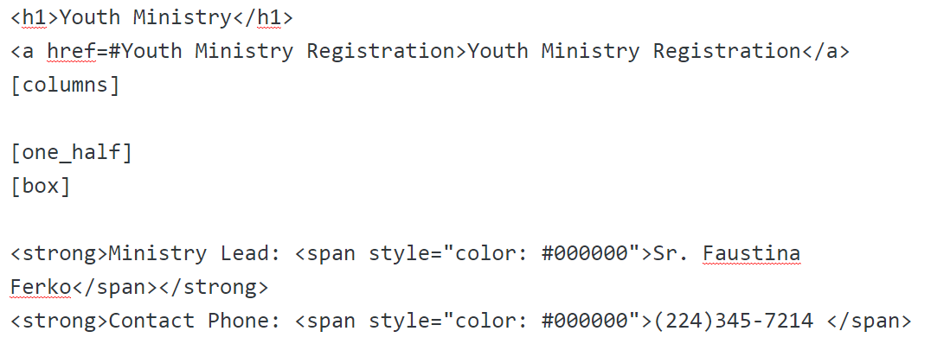
The Anchor Link In “Text” Mode:

Slide 4
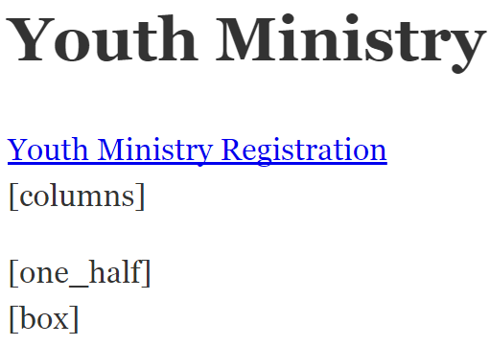
This Is What The Anchor Link Will Look Like In “Visual” Mode:

Slide 5
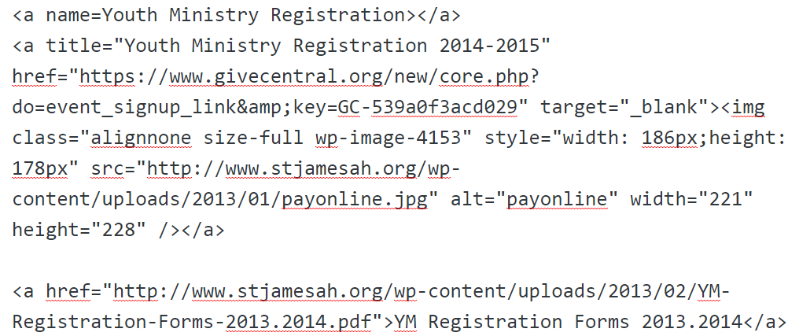
Next, Add The Anchor To The Text (In “Text” Mode):

Slide 6
The Finished Product:
Once the page is updated, clicking on the “Contact Us” link will automatically scroll the page down to where the anchor is: “Youth Ministry Registration”.

Slide 7
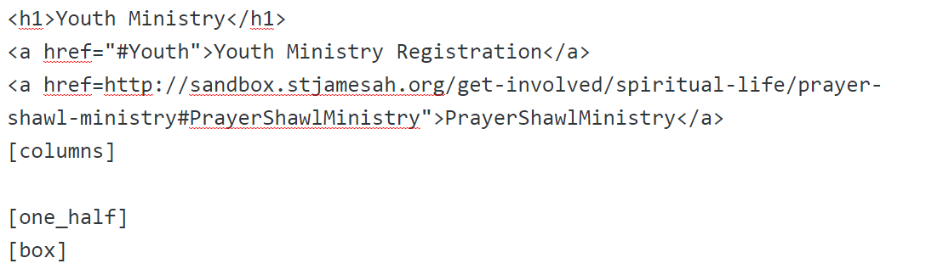
To Create An Anchor...Which Goes To Another Page…
The Following Example Is In “Text” Mode:

Slide 8
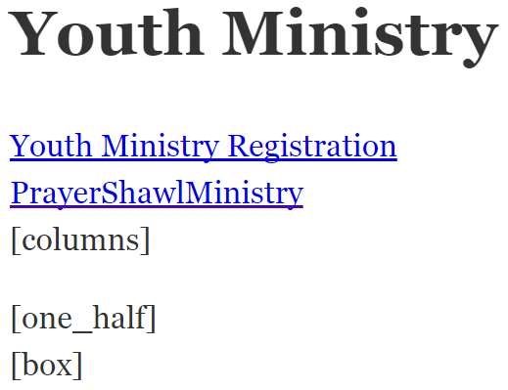
This Is What The Anchor Will Look Like On The Page (In “Text” Mode):

Slide 9
The Following Is What The Finished Webpage Will Look Like:
Youth Ministry (Sandbox Mode)

